Slide 1
The 6 Basic Principles of Good Logo Design

Slide 2

Logo is too busy.

Slide 3
The 6 Elements of Good Logo Design
Simple: Good logos are clean, uncluttered and easy to recognize.
Information from Critical Elements of an Effective Logo Design by Jeff Kear.

Slide 4
Logo is too long.

Slide 5
The 6 Elements of Good Logo Design
Simple: Good logos are clean, uncluttered and easy to recognize.
Proportional: Width=Height, The Logo should function on a business card or a billboard.
Information from Critical Elements of an Effective Logo Design by

Slide 6

Logo is a photograph (generic image).

Slide 7
The 6 Elements of Good Logo Design
Simple: Good logos are clean, uncluttered and easy to recognize.
Proportional: Width=Height, The Logo should function on a business card or a billboard.
Small Color Palette: Most famous logos use less than 3 colors.
Information from Critical Elements of an Effective Logo Design by Jeff Kear.

Slide 8

Logo has too many colors.

Slide 9
The 6 Elements of Good Logo Design
Simple: Good logos are clean, uncluttered and easy to recognize.
Proportional: Width=Height, The Logo should function on a business card or a billboard.
Small Color Palette: Most famous logos use less than 3 colors.
Information from Critical Elements of an Effective Logo Design by Jeff Kear.

Slide 10
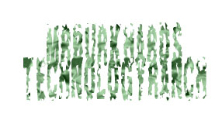
Logo is too hard to read.

Slide 11
The 6 Elements of Good Logo Design
Simple: Good logos are clean, uncluttered and easy to recognize.
Proportional: Width=Height, The Logo should function on a business card or a billboard.
Small Color Palette: Most famous logos use less than 3 colors.
Legible Fonts: Distinctive, but easy to read, letters.
Information from Critical Elements of an Effective Logo Design by Jeff Kear.

Slide 12

Logo is not unique.

Slide 13
The 6 Elements of Good Logo Design
Simple: Good logos are clean, uncluttered and easy to recognize.
Proportional: Width=Height, The Logo should function on a business card or a billboard.
Small Color Palette: Most famous logos use less than 3 colors.
Legible Fonts: Distinctive, but easy to read, letters.
Original: Uniquely identifiable and ownable.
Information from Critical Elements of an Effective Logo Design by Jeff Kear.

Slide 14
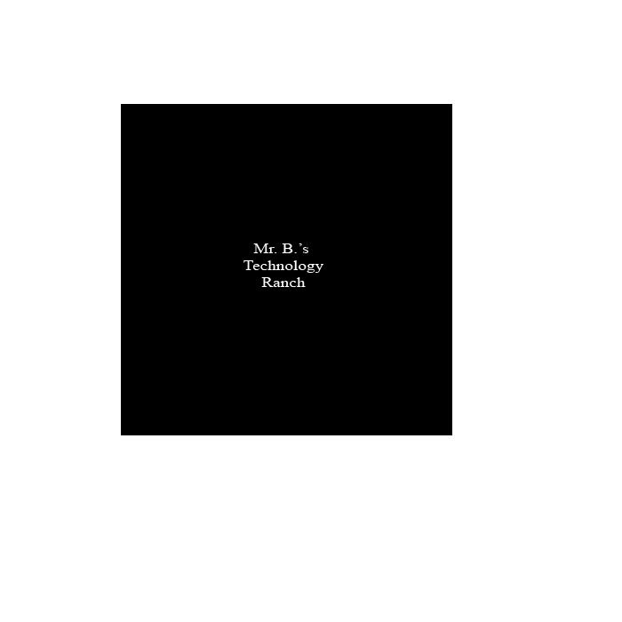
Logo has no identity.

Slide 15
The 6 Elements of Good Logo Design
Simple: Good logos are clean, uncluttered and easy to recognize.
Proportional: Width=Height, The Logo should function on a business card or a billboard.
Small Color Palette: Most famous logos use less than 3 colors.
Legible Fonts: Distinctive, but easy to read, letters.
Original: Uniquely identifiable and ownable.
Personality: Logo should express the identity of the company.
Information from Critical Elements of an Effective Logo Design by Jeff Kear.

