Slide 1
Presentation for Northern Plains Public Library
Cassi Stewart

Slide 2
Library Logo

Slide 3
Booklist

Slide 4
Business Card

Slide 5
Letterhead

Slide 6
Sign

Slide 7
Book Bags

Slide 8
T-shirts

Slide 9
The Website

Slide 10
Thank you for your time
Any questions?

Slide 11
Northern Plains Public Library Logo
By: Kayla Gross

Slide 12
The Logo

Slide 13
Business Card
In color
Black and white

Slide 14
Letterhead

Slide 15
The Website

Slide 16
T-shirt

Slide 17
On the Building

Slide 18
Questions?

Slide 19
Library Logo Presentation
By Zach Wagner

Slide 20
My
Library
Logo
Idea

Slide 21
Logo Embedded in to Your Website

Slide 22
Logo Embedded into My Version Of Your Website

Slide 23
Letterhead And Business Card Ideas

Slide 24
Reading List
Idea

Slide 25
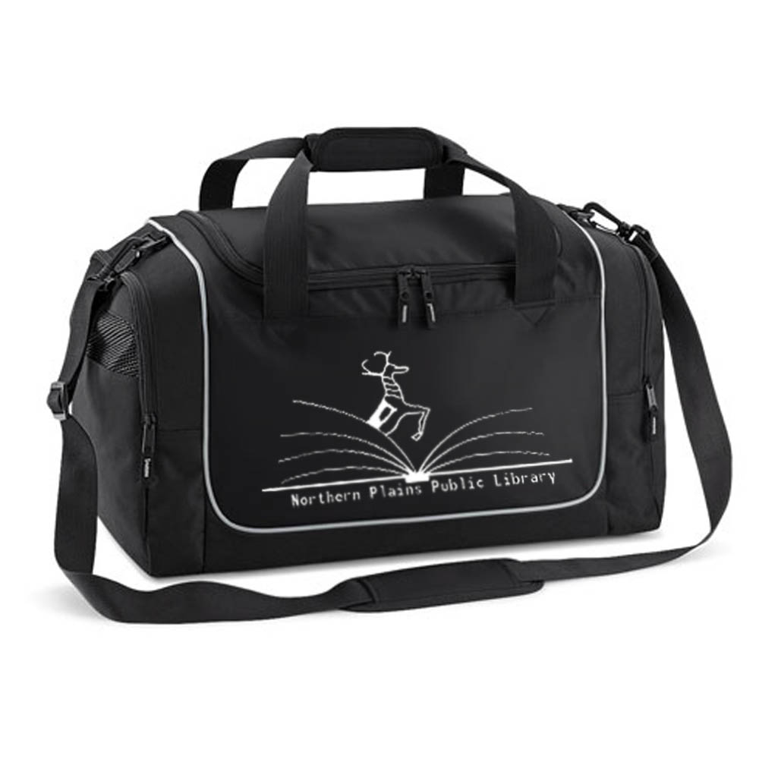
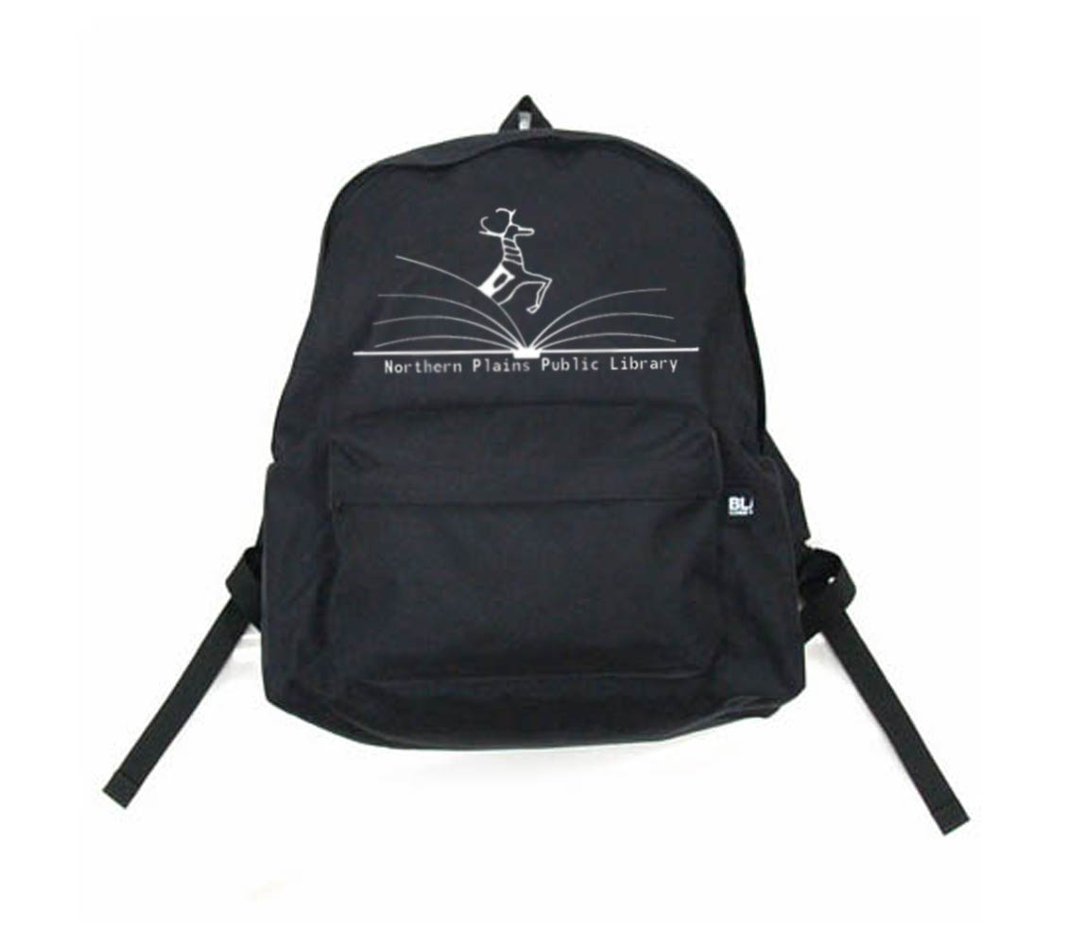
Logo On Book Bag
Logo on Athletic Bag

Slide 26
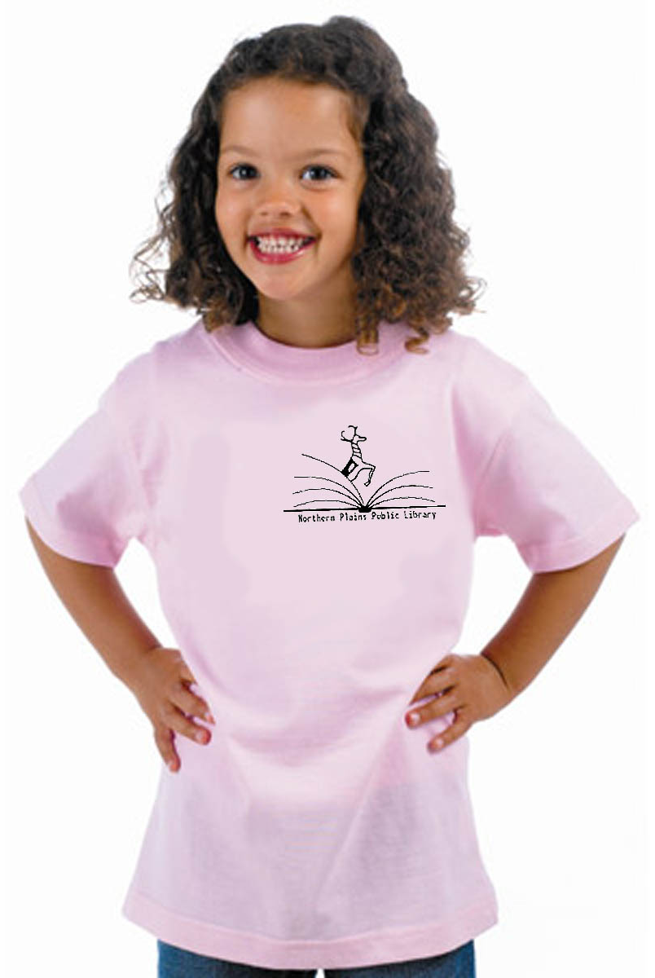
Children’s Shirt with Logo

Slide 27
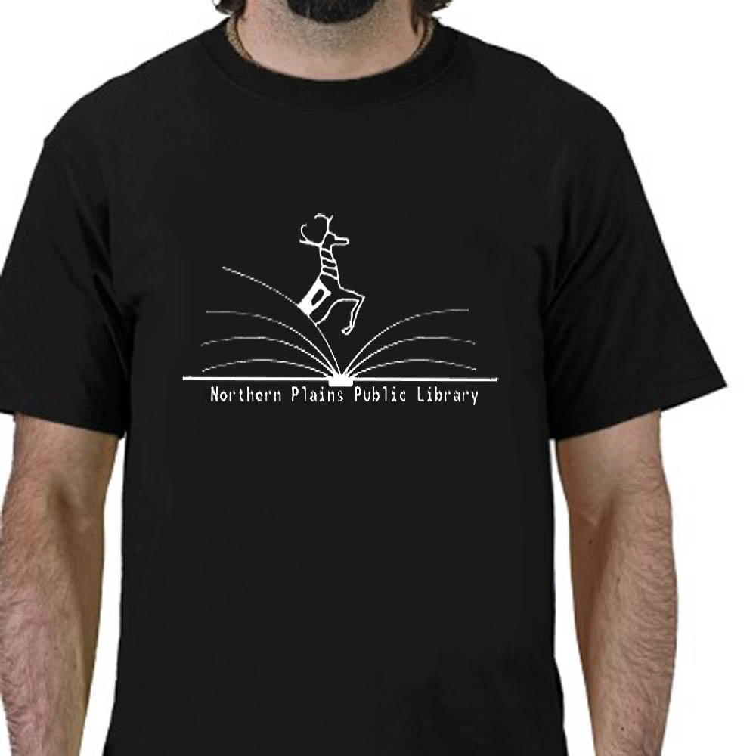
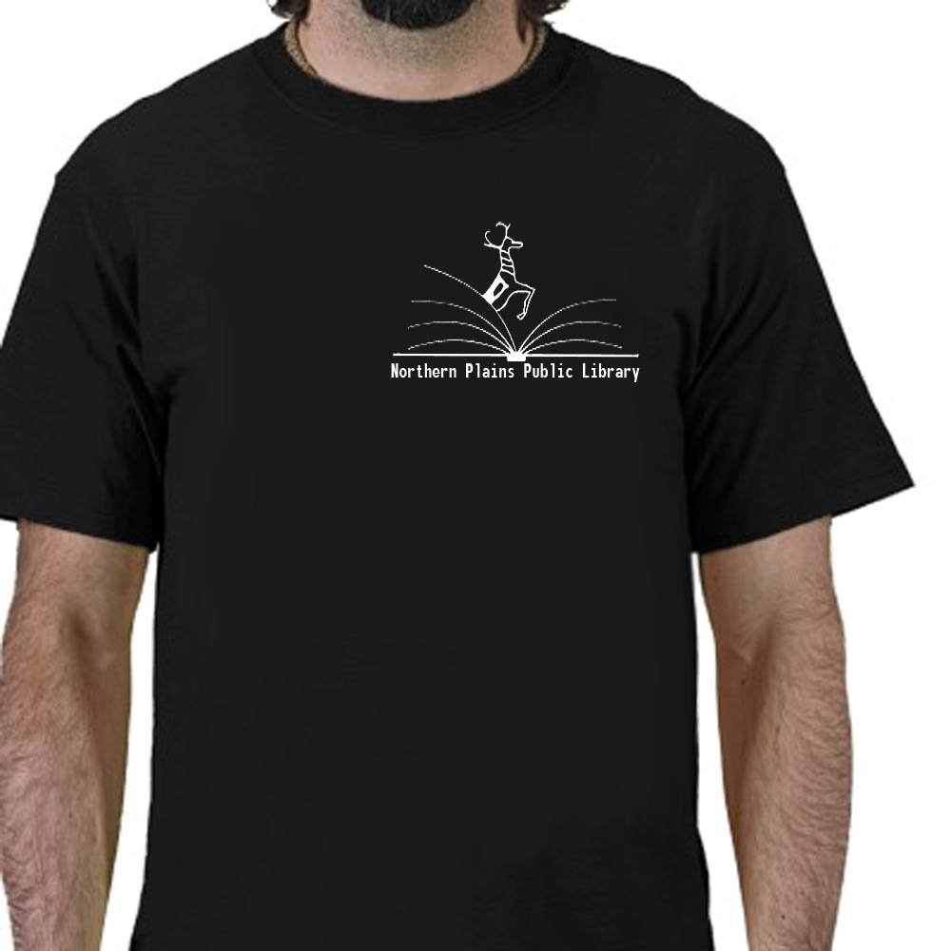
Adults Shirt with logo

Slide 28
Thank you for your Time!
Questions?

